Slide 1
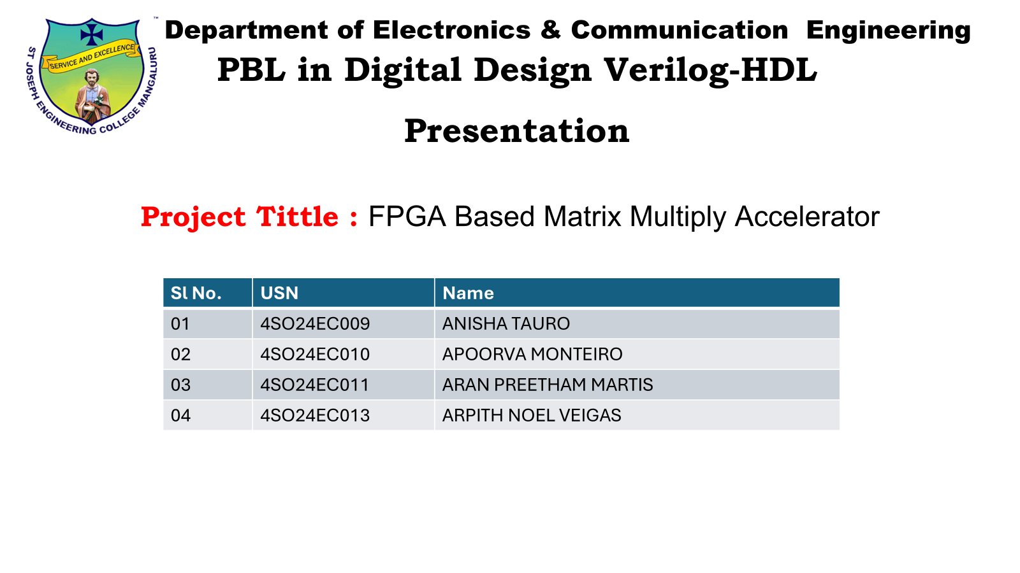

Slide 2
INTRODUCTION
AI and Machine Learning are used everywhere today, from face recognition to medical diagnosis. At the core of every neural network is one heavy operation, which is matrix multiplication. CPUs are too slow for this because they handle operations one at a time. GPUs are faster but they consume a lot of power and are costly. FPGAs offer a better solution. They can be programmed to run many multiplications in parallel at the same time, which makes them faster and more power efficient. In this project, we have designed an FPGA based parallel matrix multiplication accelerator using Verilog HDL, built from the basic arithmetic components up to a complete system

Slide 3
PROBLEM STATEMEMT:
Matrix multiplication has a time complexity of O(n³), which means as the matrix size doubles, the computation time increases by eight times. This is not practical at all for real time AI applications where speed matters a lot.
Existing hardware solutions like CPUs and GPUs either use too many resources, consume too much power, or do not scale well for larger matrix sizes. There is a clear need for a dedicated hardware solution that is both fast and resource efficient.
Our project aims to design an FPGA based parallel matrix multiplication accelerator that solves this problem. We start from the basic arithmetic building blocks and work our way up to a complete system that is efficient in both speed and resource usage.

Slide 4
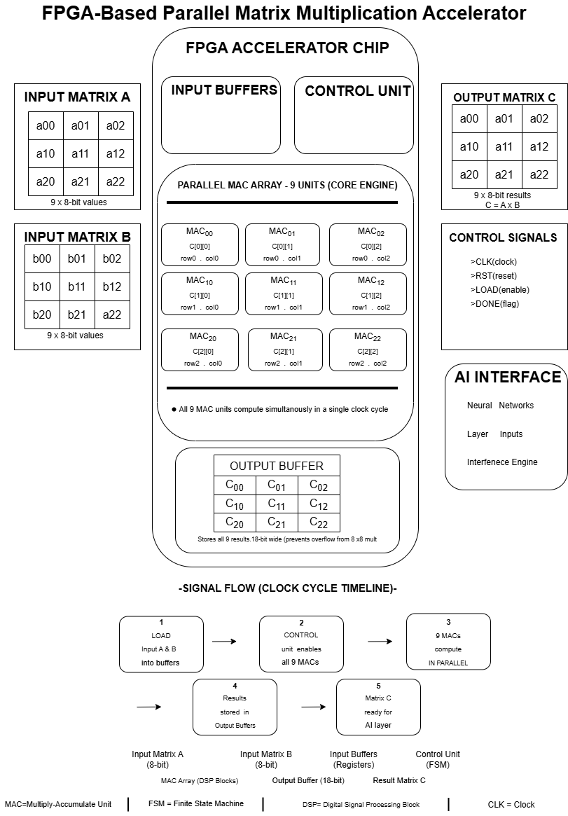
Architecture

Slide 5
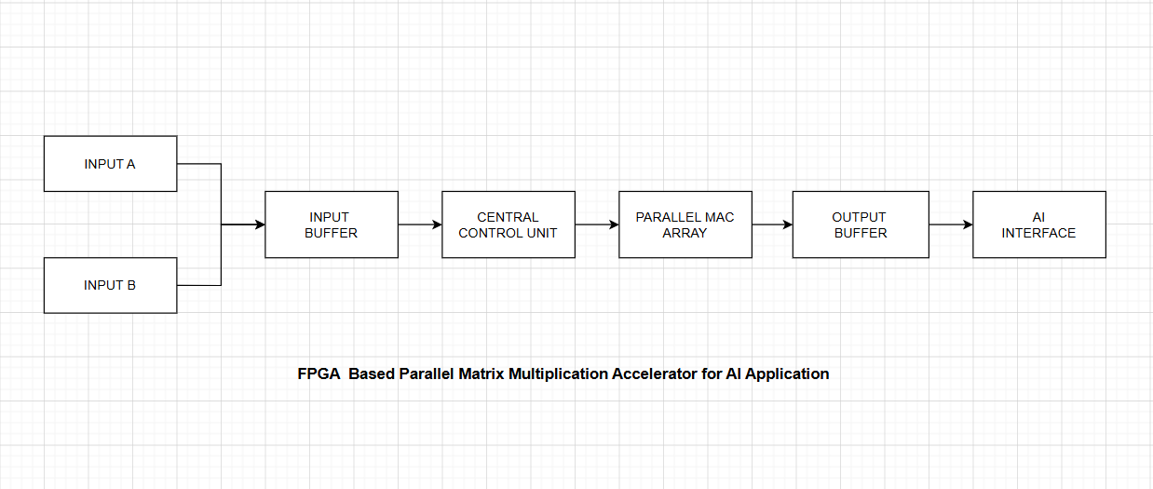
Block Diagram

Slide 6
Theoretical Background
1. 8x8 Multiplier:
Takes two 8-bit inputs A and B and gives a 16-bit product output
Generates partial products and sums them up using ripple carry adders
Formula: P = A x B
2. 18-bit Ripple Carry Adder:
Adds two 18-bit numbers along with a carry input
Made up of 18 full adders connected in a chain
Used for accumulation in the MAC operation
Also detects overflow using the carry bits
Formula: S = A + B
3. D Flip Flop:
Stores one bit of data and updates it on every rising clock edge
Used to hold intermediate and final values in the system
Supports synchronous and asynchronous reset
Formula: Q(t+1) = D

Slide 7
System Design & Simplification
Designed a 3×3 Parallel MAC Array with 9 MAC units, each handling one element of the output matrix simultaneously
Each MAC unit is built from three leaf cells: an 8×8 Multiplier, an 18-bit Adder, and a D Flip-Flop
A Control Unit (FSM) manages clock, reset, load, and done signals to sequence operations
Input Buffers feed matrix A and B elements (8-bit each) in an organized flow to reduce delay
Output Buffer stores result matrix C in higher bit-width to prevent overflow
Simplification choice: started from leaf cell level instead of a full complex system, making debugging, verification and scaling easier.

Slide 8
Software Requirements
Tool Used: Vivado Design Suite 2018.2
Code Writing :All three leaf cell modules (D Flip-Flop, 8×8 Multiplier, 18-bit Ripple Carry Adder) written in Verilog HDL within Vivado
Testbench Simulation : Testbenches written and simulated in Vivado's built-in simulator to verify functional correctness
Waveform Analysis : Simulation waveforms generated and analyzed within Vivado to confirm expected output behavior
RTL/Circuit Diagram : Schematic views of each module generated using Vivado's RTL Analysis feature
draw.io (diagrams.net) : Was used to design the Block Diagram and Architecture Diagram of the system

Slide 9
Implementation
D Flip-Flop: Implemented in three variants : Basic, Synchronous reset and Asynchronous reset. It captures data on positive clock edge (Q(t+1) = D)
8×8 Multiplier: Generates 8 partial products using AND operations, then sums them stage-by-stage using 7 cascaded 18-bit Ripple Carry Adder instances and it produces a 16-bit product
18-bit Ripple Carry Adder: Built from 18 chained Full Adder instances. It includes carry-out and overflow detection, which used both standalone and inside the multiplier
Each module was paired with a dedicated testbench covering edge cases (zero, max value, carry-in, powers of two)
All designs verified through RTL diagrams and simulation waveforms in Vivado

Slide 10
Results & Verification
D Flip-Flop: Correctly captured D on every rising clock edge; synchronous reset waited for clock, asynchronous reset responded immediately mid-cycle
8×8 Multiplier: Passed all 8 test cases including edge cases like 255×255 = 65025 and 0×0 = 0
18-bit Ripple Carry Adder: Correctly computed sums for all 5 test vectors including max-value overflow and carry-in effects .
All three leaf cells produced matching waveform outputs against expected values
RTL schematics confirmed correct gate-level structure for each module
Foundation validated for integration into the full parallel MAC-based matrix multiplication system

Slide 11
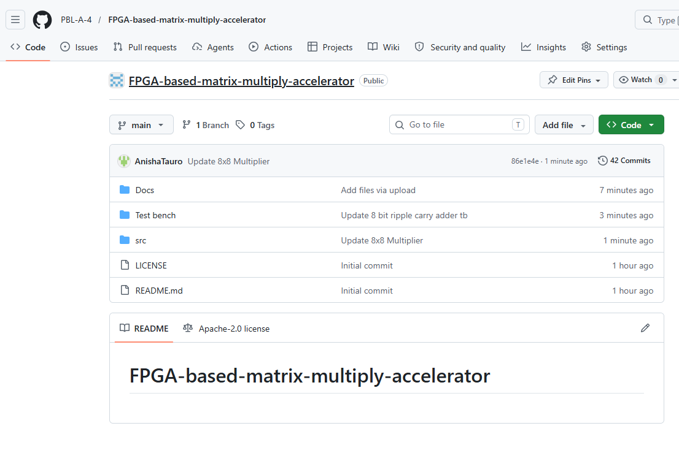
GITHUB
o me
https://github.com/PBL-A-4/FPGA-based-matrix-multiply-accelerator.git

